Slide 1


SWIFTGUARD ANTIVIRUS SCANNER
Presentation by Mohamed Khaled Nassar

Slide 2




INTRODUCTION
OVERVIEW
Welcome to the presentation on SwiftGuard Antivirus Scanner.
ARCHITECTURE AND CORE MODULES
In this presentation, we will delve into the SwiftGuard Antivirus Scanner Codebase Overview, Architecture and Core Modules, Innovative Approaches, Technical Deep Dive, Future Roadmap, Conclusion
INNOVATIVE APPROACHES
TECHNICAL DEEP DIVE
FUTURE ROADMAP

Slide 3
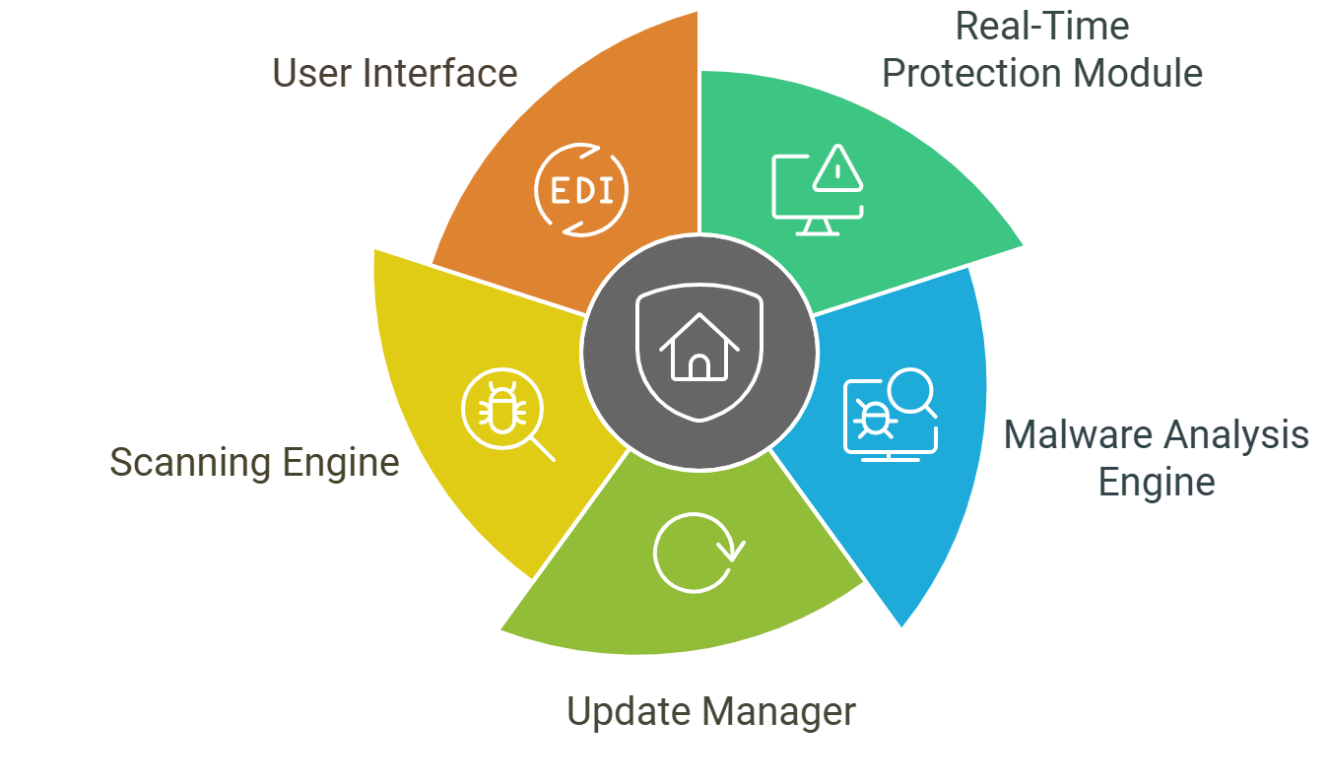

INTRODUCTION
SwiftGuard Antivirus Scanner (SGAVS) is a state-of-the-art cybersecurity solution designed to provide comprehensive protection against evolving digital threats. Built with a modular and extensible architecture, SGAVS ensures both robustness and scalability. The core modules include:
OVERVIEW
ARCHITECTURE AND CORE MODULES
INNOVATIVE APPROACHES
TECHNICAL DEEP DIVE
FUTURE ROADMAP

Slide 4
INTRODUCTION
1- Real-Time Protection Module:
Continuously monitors file system activities to detect malicious behavior using heuristics and behavior-based detection techniques.
OVERVIEW
ARCHITECTURE AND CORE MODULES
2- Malware Analysis Engine:
Combines signature-based detection with advanced machine learning models to identify both known and unknown threats.
INNOVATIVE APPROACHES
3- Update Manager:
Delivers secure, incremental updates to ensure the antivirus database and software components remain current with minimal resource consumption.
TECHNICAL DEEP DIVE
FUTURE ROADMAP

Slide 5
INTRODUCTION
OVERVIEW
4- Scanning Engine:
Supports quick scans, full system scans, and targeted scans for individual files or URLs, leveraging multi-threading for efficiency.
ARCHITECTURE AND CORE MODULES
INNOVATIVE APPROACHES
5- User Interface (UI):
Developed with Tkinter for cross-platform compatibility, offering a user-friendly design with progress tracking and detailed logs.
TECHNICAL DEEP DIVE
FUTURE ROADMAP

Slide 6

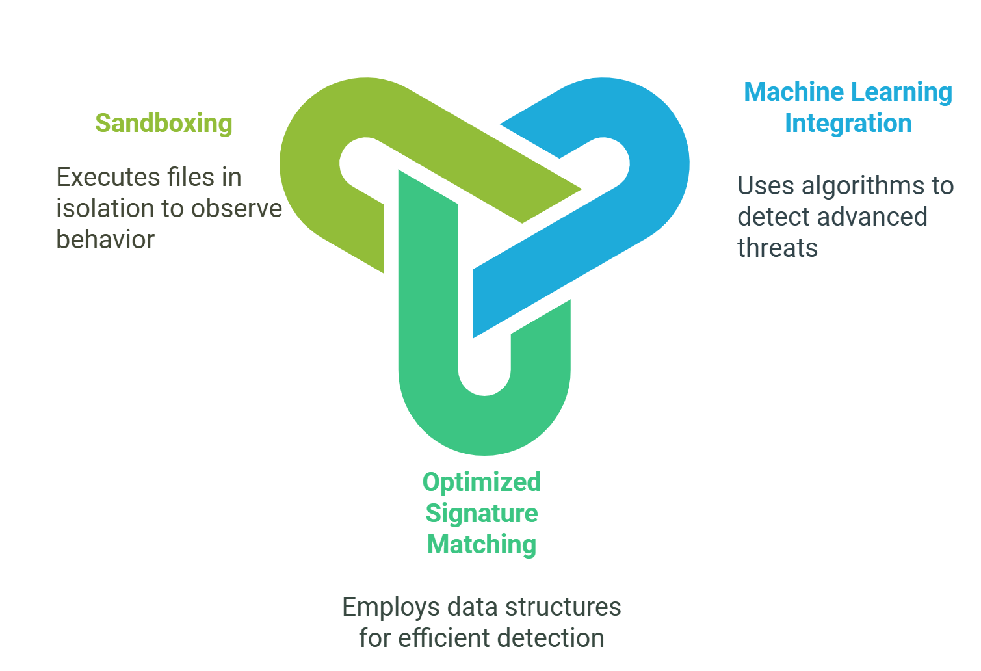
INTRODUCTION
OVERVIEW
ARCHITECTURE AND CORE MODULES
INNOVATIVE APPROACHES
TECHNICAL DEEP DIVE
FUTURE ROADMAP

Slide 7
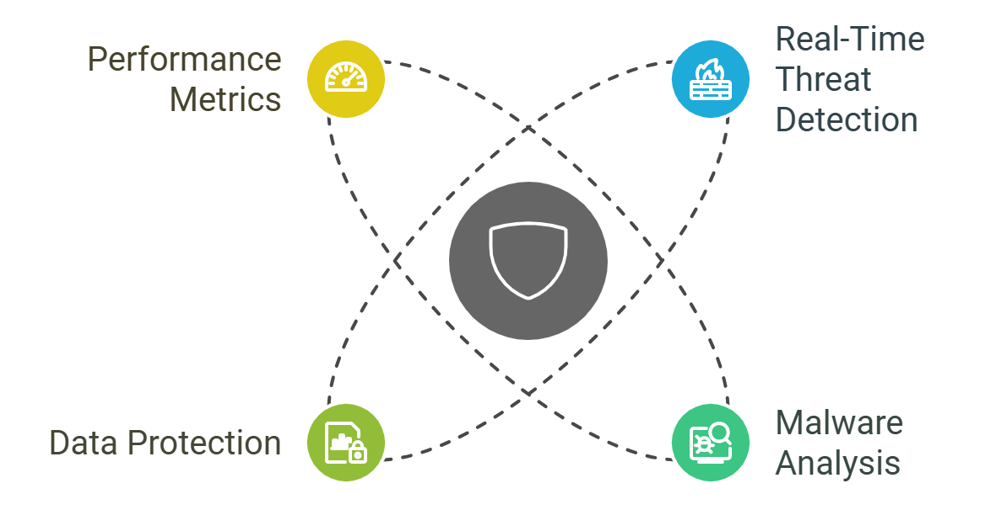
INTRODUCTION
Technical Deep Dive:-
OVERVIEW
ARCHITECTURE AND CORE MODULES
INNOVATIVE APPROACHES
TECHNICAL DEEP DIVE
FUTURE ROADMAP

Slide 8
INTRODUCTION
Real-Time Threat Detection
OVERVIEW
File System Hooks: Intercepts system calls for early detection of potential threats.
Anomaly Detection: Identifies unexpected changes in critical system areas to preemptively flag threats.
ARCHITECTURE AND CORE MODULES
Malware Analysis
INNOVATIVE APPROACHES
Employs a dual-layer analysis system:
Static Analysis: Extracts metadata and scans file contents without execution
.
Dynamic Analysis: Observes file behavior in a controlled runtime environment.
TECHNICAL DEEP DIVE
FUTURE ROADMAP

Slide 9
INTRODUCTION
Data Protection
OVERVIEW
Encryption: Employs AES-256 to secure sensitive data and a secure vault for user-protected files, inaccessible to unauthorized processes.
ARCHITECTURE AND CORE MODULES
Performance Metrics
Scanning Speed: Processes 10,000 files in under 2 minutes on an average workstation.
Resource Usage: CPU utilization remains below 15% during active scans, with memory usage under 200 MB.
Detection Accuracy: Achieves a 98.7% detection rate in independent benchmarking tests.
INNOVATIVE APPROACHES
TECHNICAL DEEP DIVE
FUTURE ROADMAP

Slide 10
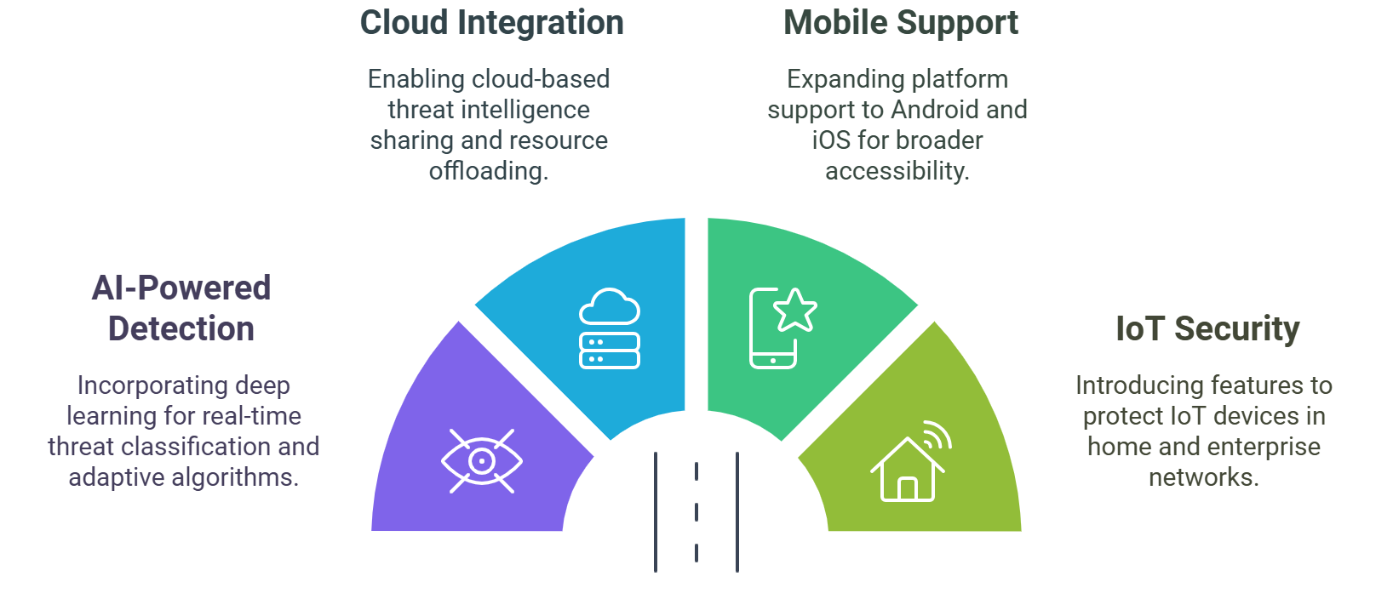
INTRODUCTION
Planned Enhancements
OVERVIEW
ARCHITECTURE AND CORE MODULES
INNOVATIVE APPROACHES
TECHNICAL DEEP DIVE
FUTURE ROADMAP

Slide 11

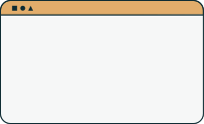

SwiftGuard Antivirus Scanner delivers unparalleled security through its advanced detection mechanisms, modular architecture, and resource-efficient design. By combining cutting-edge technology with user-focused features
CONCLUSION
SGAVS provides a reliable and scalable solution for staying ahead in the cybersecurity landscape. Its ongoing enhancements and future-focused roadmap ensure continued leadership in protecting against evolving digital threats.

Slide 12

THANK YOU
Presentation by Mohamed Khaled Nassar

